Slide 1
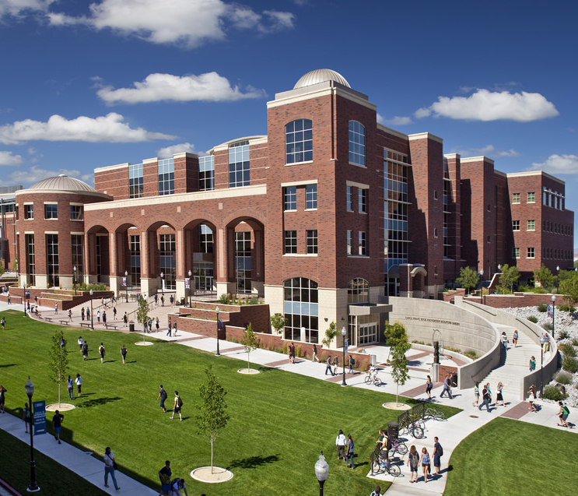
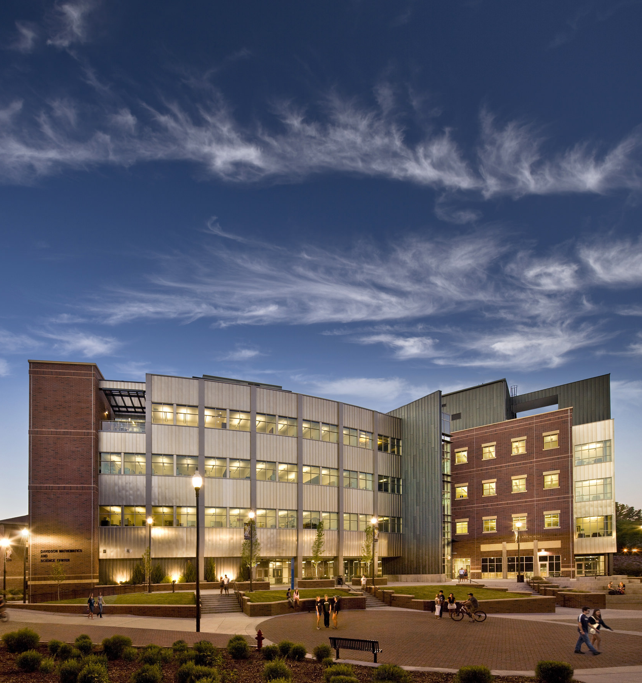
Elizabeth Nubel
enubel@unr.edu
University of Nevada, Reno
est. 1874
$850 million in new facilities
21,500 STUDENTS
17:1 STUDENT-TO-FACULTY RATIO
290 acre campus
60+ Research facilities

Slide 2
ADMISSIONS
3.0 ACADEMIC gpa (WEIGHTED)
4 YEARS eNGLISH
3 YEARS mATH (ALG i & HIGHER)
3 YEARS NATURAL SCIENCE
3 YEARS SOCIAL SCIENCE
act OR SAT optional
CORE CLASSES +
(MIN 2.0 agpa WEIGHTED)
22 act
OR
1120 SAT
Core classes +
Graduate with advanced diploma

Slide 3
APPLY!
APPLY ONLINE
$60 APPLICATION FEE
OFFICIAL TRANSCRIPT
IMMUNIZATION RECORDS
ACT/SAT (OPTIONAL)
APPLICATION OPEN NOW!
APPLICATION DEADLINE FEBRUARY 1

Slide 4
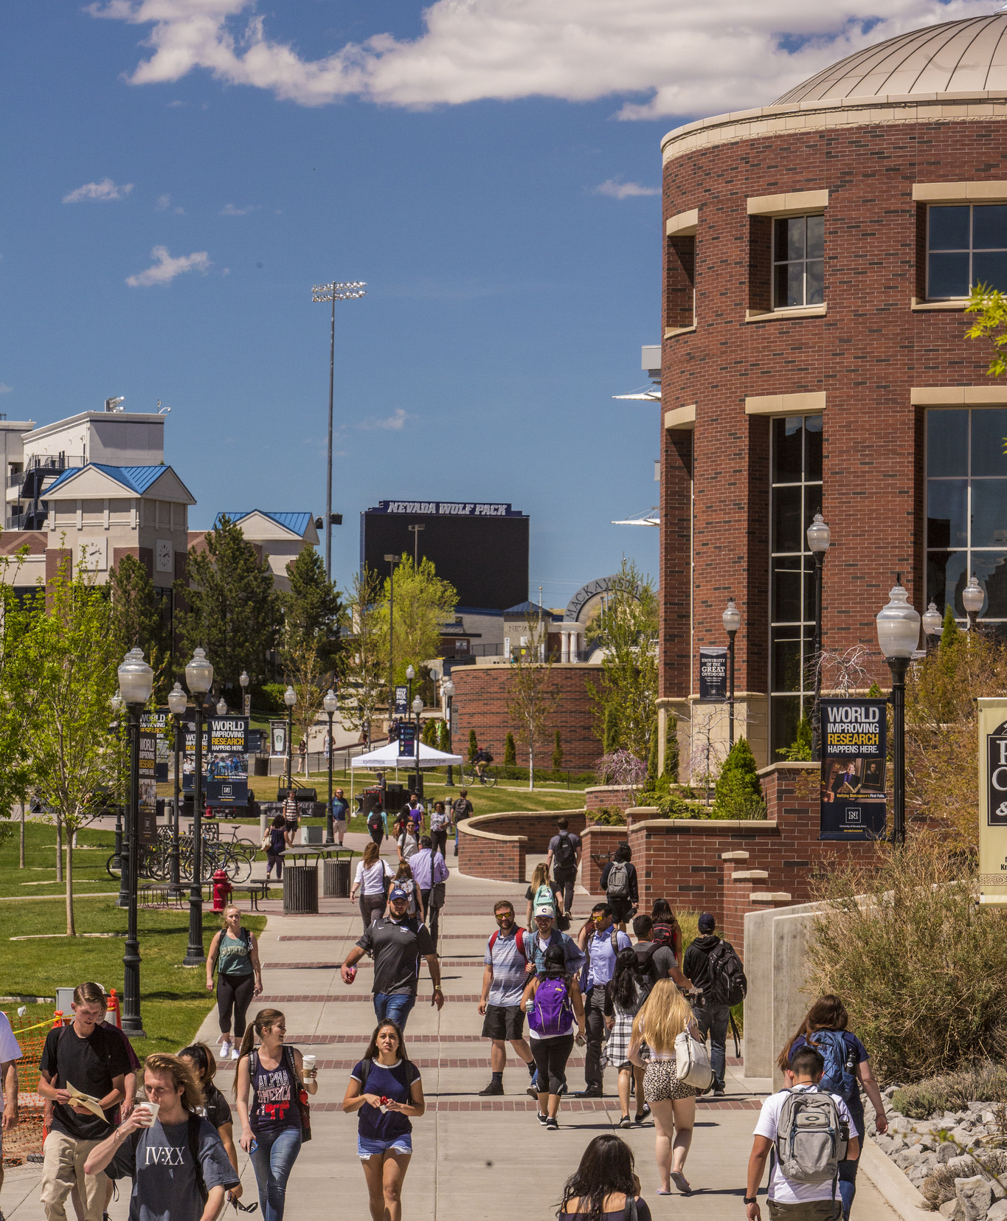
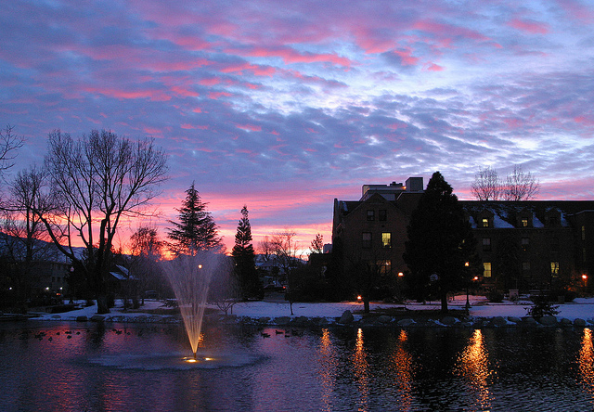
COSTS
15 CREDITS PER SEMESTER
X 2 SEMESTERS
30 CREDITS PER YEAR
X $256 PER CREDIT
$7,680 per year
AVERAGE TIER 1
$34,000
PER YEAR
OTHER COSTS: HOUSING, MEAL PLAN, FEES, TEXTBOOKS, ETC.

Slide 5
FAFSA
FREE APPLICATION FOR FEDERAL STUDENT AID
FAFSA.ED.GOV
OCTOBER 1
FEBRUARY 15
IF NOT FAFSA ELIGIBLE:
Institutional methodology

Slide 6
Nevada Guarantee
$9500 GUARANTEED GIFT AID
COVERS:
CLASSES
FEES
TEXTBOOKS
Requirements:
Pell eligible or
family income of $50,000 or less
Nevada Resident
Full time student (15 credits)
Fafsa OR IM BY FEBRUARY 15

Slide 7
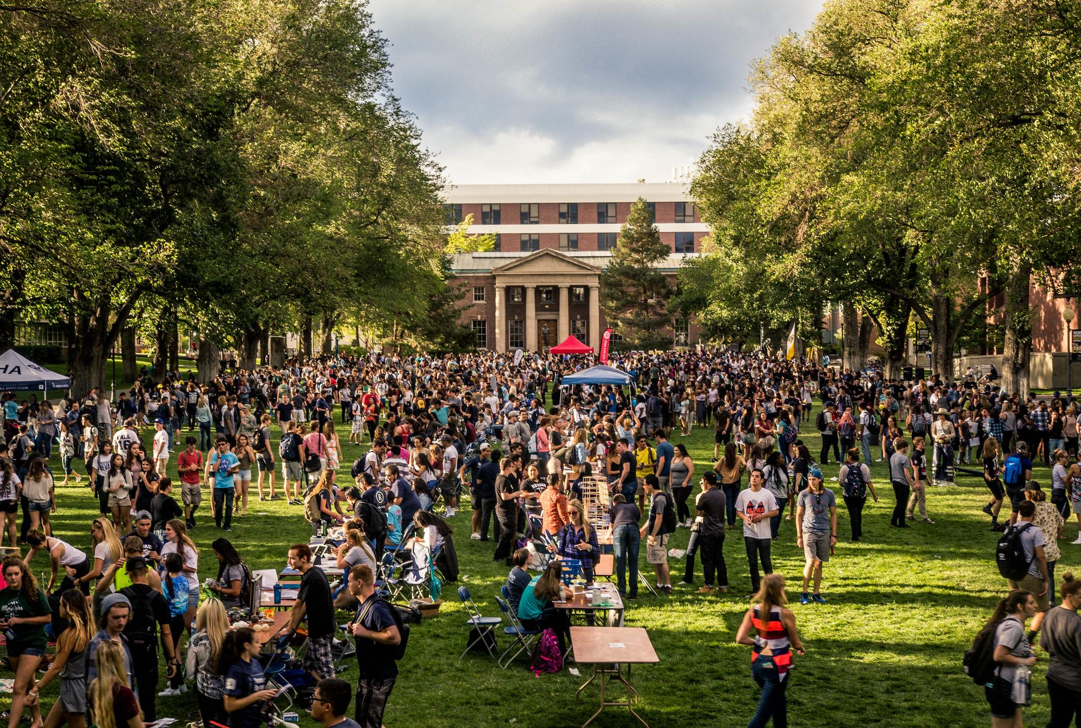
Fee Waivers
Former Foster Youth Fee Waiver
Covers entire cost of tuition + aid stacked
Foster Care at or after age 14
FAFSA Completion
Foster Youth Fee Waiver Application
Proof student was in Foster Care
Native Student Fee Waiver
Covers entire cost of tuition after federal gift aid
Membership or proof of descendancy of Nevada tribe
FAFSA Completion
Native American Fee Waiver Application

Slide 8
MILLENNIUM SCHOLARSHIP
EXTERNAL SCHOLARSHIPS
HIGH SCHOOL SCHOLARSHIPS
APPLY BY FEBRUARY 1!
SCHOLARSHIP APPLICATION
FEB 15
SUBMIT FAFSA/IM
FEB 15
NOTIFY
APRIL
SCHOLARSHIPS

Slide 9
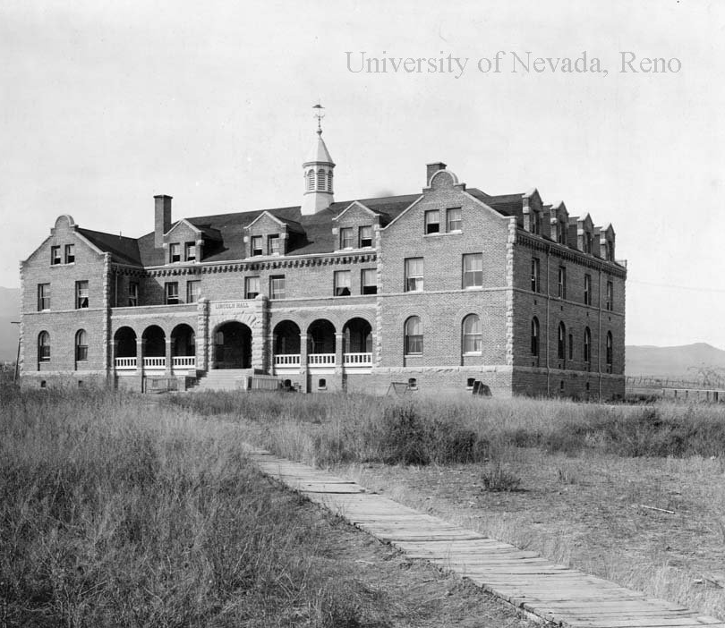
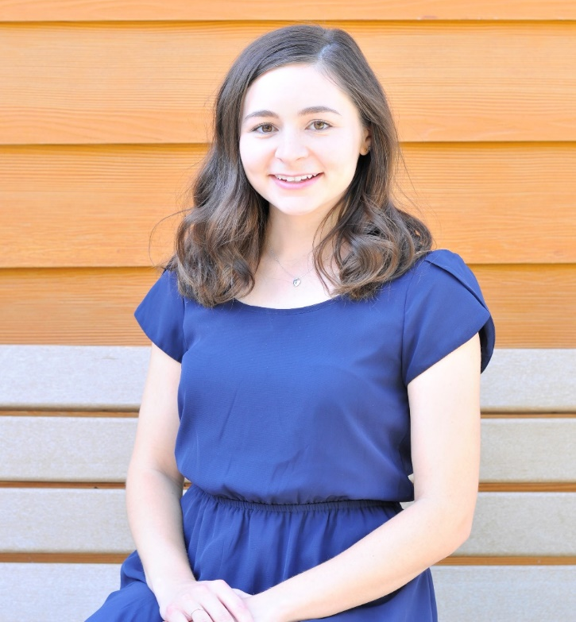
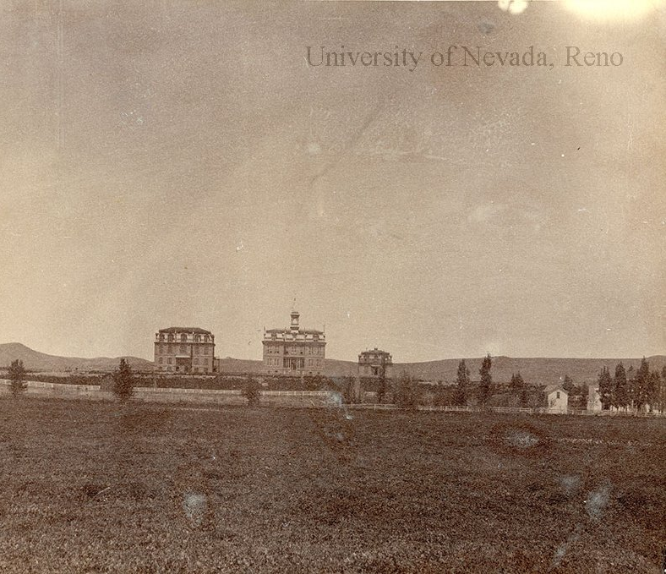
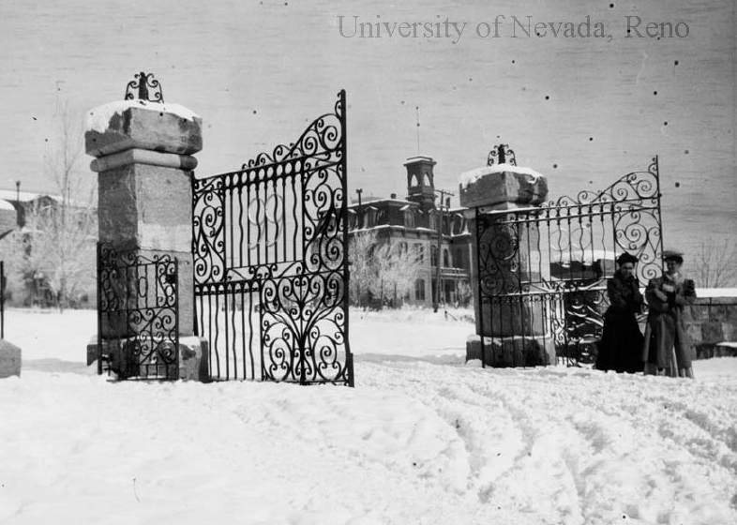
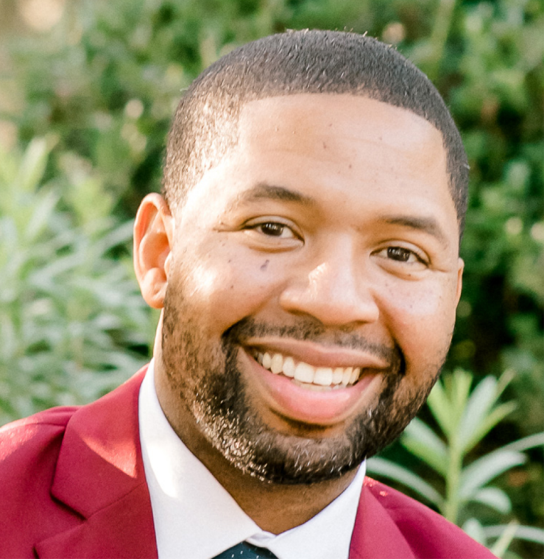
ELIZABETH NUBEL Davis
1911
1896
ENUBEL@UNR.EDU
TEXT: 775-204-6115
QOWENS@UNR.EDU
1903
1890
TEXT: 775-204-3505
Quentin Owens-Smith

